Slide 1
TSS: Trivia Night
30 November 2022

Slide 2
Proofs

Slide 3
Proofs
3 Minutes per question
You’ll be shown a part of a proof
Every minute, more of the proof will be shown
Scoring:
  +6/+4/+2

Slide 4
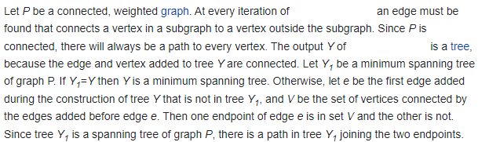
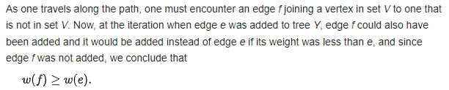
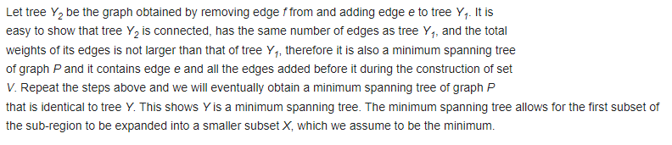
Notes:
Prim’s Algorithm

Slide 5
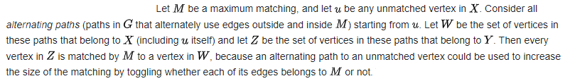
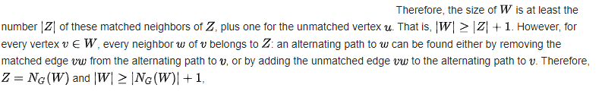

Slide 6
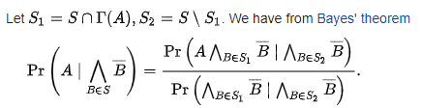
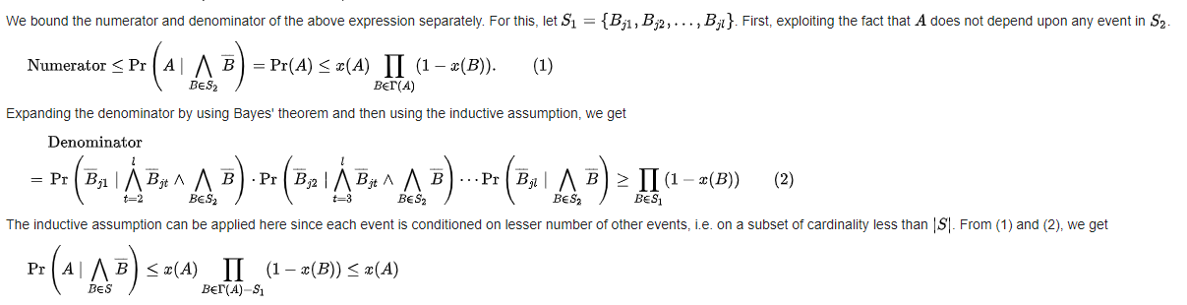
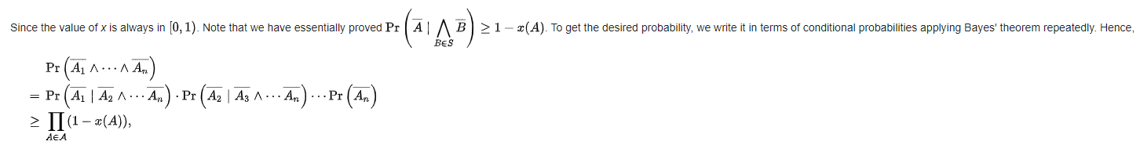
Notes:
Lovasz Local Lemma

Slide 7
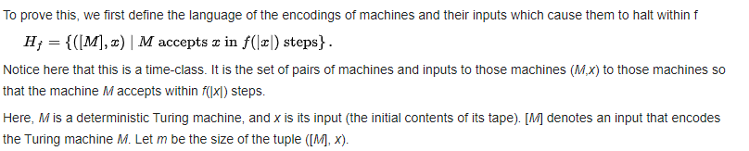
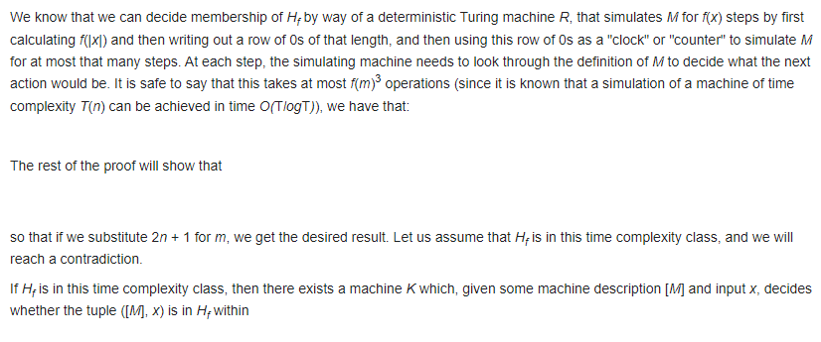
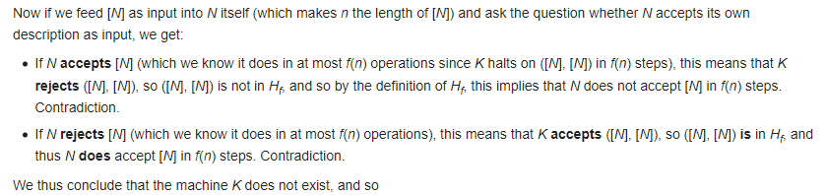
Notes:
Time Hierarchy Theorem

Slide 8
True/False/Open

Slide 9
True/False/Open
21 Minutes total
Scoring:
  +5/-10 for first 7 minutes
  +4/-6 for next 7 minutes
  +3/-3 for last 7 minutes
  First team to answer a question right gets bonus +2 points.

Slide 10
True/False/Open
21 Minutes total
Scoring:
  +5/-10 for first 7 minutes
  +4/-6 for next 7 minutes
  +3/-3 for last 7 minutes
  +2/-2 for last 7 minutes
  First team to answer a question right gets bonus +2 points.

Slide 11
Solution Discussion

